Slide 1
LASER TECHNOLOGY
LASER
LASER
LASER
Svetlichnaya Alina

Slide 2
WHAT IS IT?
WHAT IS IT?
WHAT IS IT?
WHAT IS IT?
A laser produces a very narrow beam of light that is useful in many technologies and instruments. The letters in the word laser stand for Light Amplification by Stimulated Emission of Radiation.

Slide 3
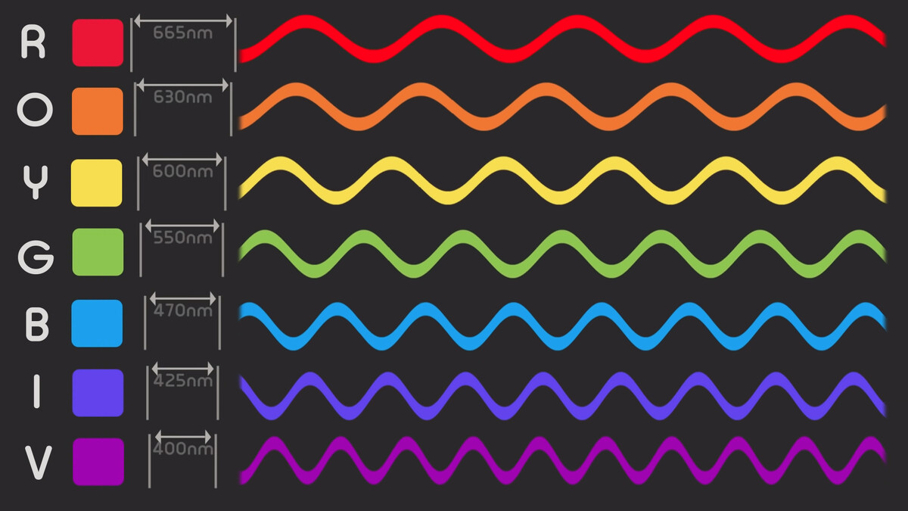
HOW DOES A LASER WORK?
1
2
3
Distance between the peaks of a wave is called the wavelength
Each color of light has a different wavelength
Lasers produce a narrow beam of light in which all of the light waves have very similar wavelengths

Slide 4

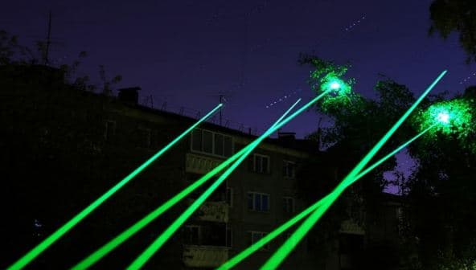
Laser beams can travel very long distances.

Slide 5
WHERE IS IT USED?
PRECISION TOOLS
DELICATE SURGERIES
PROCESSING INFORMATION
LASER PRINTERS
BAR CODE SCANNERS
SPECTROMETER

Slide 6
THANK YOU FOR ATTENTION
THANK YOU
THANK YOU
THANK YOU
THANK YOU
THANK YOU
THANK YOU

